Slide 1
CSE473/573 – Stereo and Multiple View Geometry
Presented by
Radhakrishna Dasari

Slide 2
Contents
Stereo Practical Demo
Camera Intrinsic and Extrinsic parameters
Essential and Fundamental Matrix
Multiple View Geometry
Multi-View Applications

Slide 3
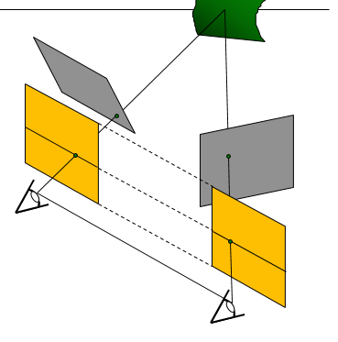
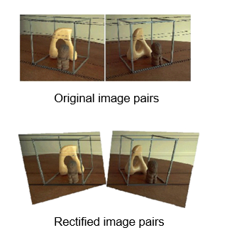
Stereo Vision Basics
Stereo Correspondence – Epipolar Epipolar constraint
Rectification
Pixel matching
Depth from Disparity
C. Loop and Z. Zhang. Computing Rectifying Homographies for Stereo Vision. IEEE Conf. Computer Vision and Pattern Recognition, 1999.

Slide 4
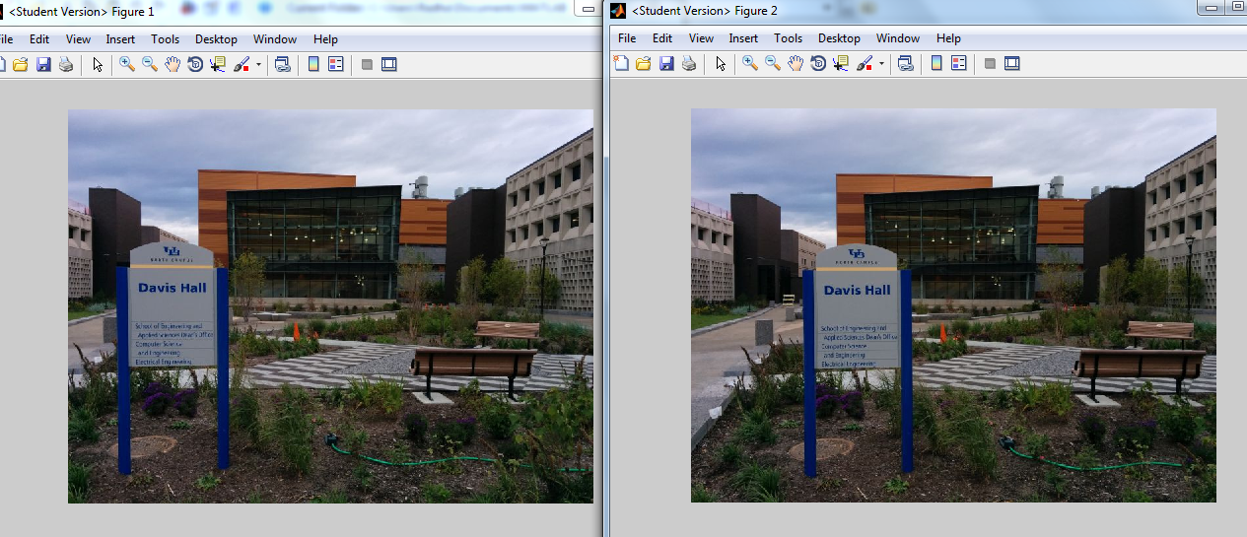
Stereo Rectification
Rectification is the process of transforming stereo images, such that the corresponding points have the same row coordinates in the two images.
It is a useful procedure in stereo vision, as the 2-D stereo correspondence problem is reduced to a 1-D problem
Let’s see the rectification pipeline when we have are two images of the same scene taken from a camera from different viewpoints

Slide 5
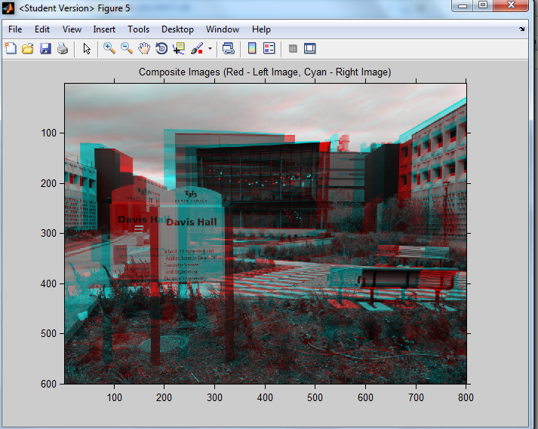
Stereo Input Images
Superposing the two input images on each other and compositing

Slide 6
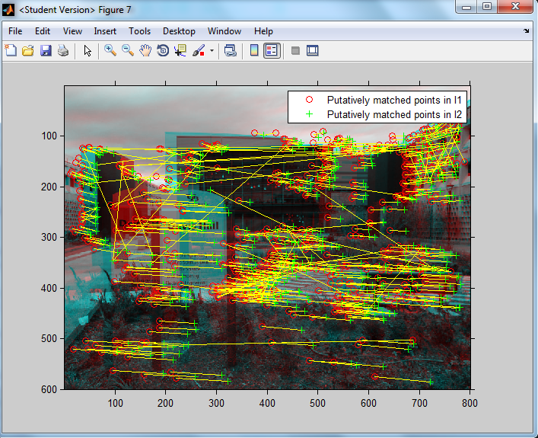
Matching Feature Points

Slide 7
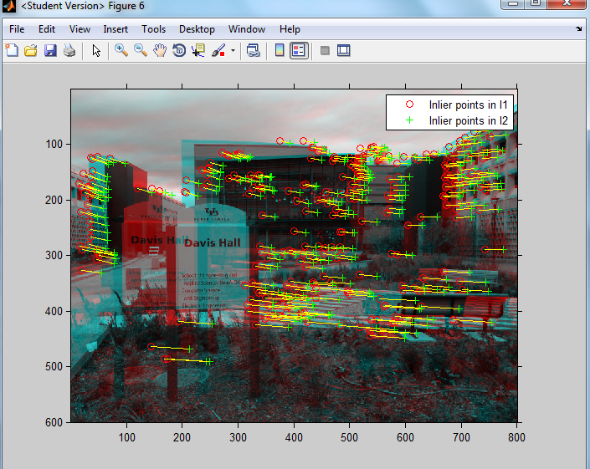
Eliminating outliers using RANSAC
We can impose geometric constraints while applying RANSAC for eliminating outliers

Slide 8
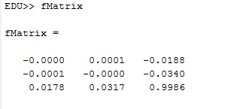
Estimate Fundamental Matrix using Matched Points
fMatrix = estimateFundamentalMatrix( matchedPtsOut.Location, matchedPtsIn.Location);

Slide 9
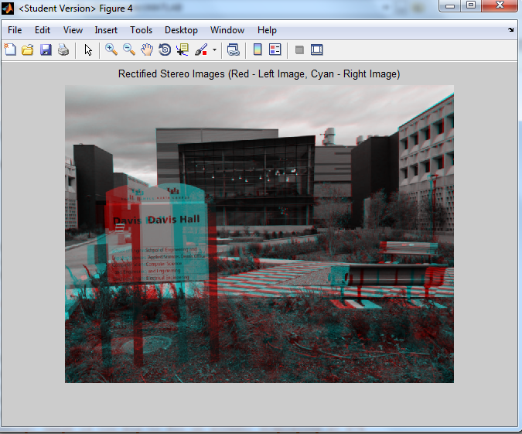
Rectified Input Stereo Images

Slide 10
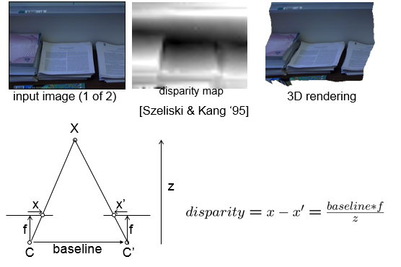
Depth From Disparity

Slide 11
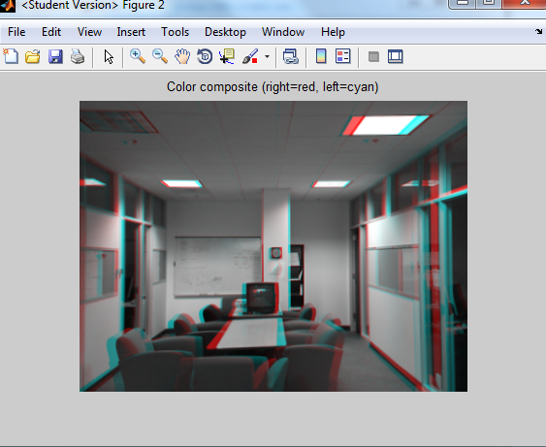
Rectified Stereo Images as Input

Slide 12
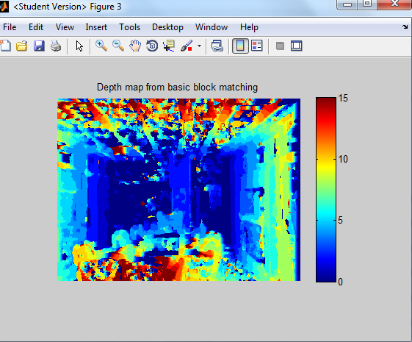
Disparity map using Block Matching
There are noisy patches and bad depth estimates, especially on the ceiling.
These are caused when no strong image features appear inside of the pixel windows being compared.
The matching process is subject to noise since each pixel chooses its disparity independently of all the other pixels.

Slide 13
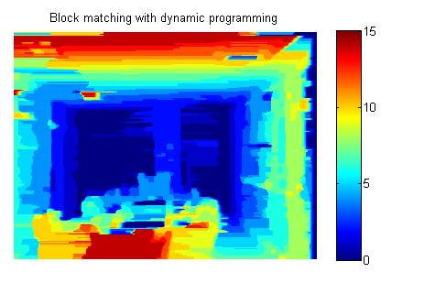
Disparity map using Dynamic Programming – Simple Example
For optimal path we use the underlying block matching metric as the cost function
constrain the disparities to only change by a certain amount between adjacent pixels (Smoothness of disparity) Lets say +/- 3 values of the neighbors
We assign a penalty for disparity disagreement between neighbors.
Hence most of the noisy blocks will be eliminated. Good matches will be preserved as block-matching cost function will dominate the penalty assigned for disparity disagreement

Slide 14
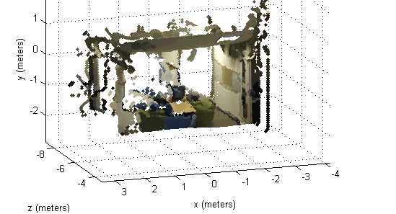

Depth from Disparity and Back-Projection
With a stereo depth map and knowledge of the intrinsic parameters (focal length, image center) of the camera, it is possible to back-project image pixels into 3D points
Intrinsic Parameters of a camera are obtained using camera calibration techniques

Slide 15
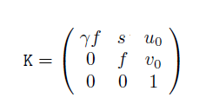
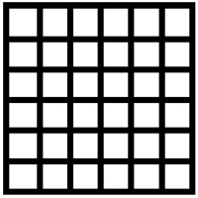

Camera Intrinsic Parameters
Camera Calibration Matrix ‘K’ – 3x3 Upper triangular Matrix
Constitutes – Focal length of the camera ‘f’ , Principal Point (u0,v0), aspect ratio of the pixel ‘γ’ and the skew ‘s’ of the sensor pixel
Intrinsic parameters can be estimated using camera calibration techniques
Ideal image sensor
Sensor pixel with skew

Slide 16
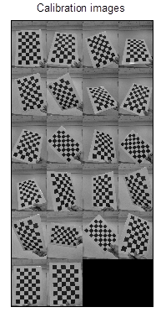
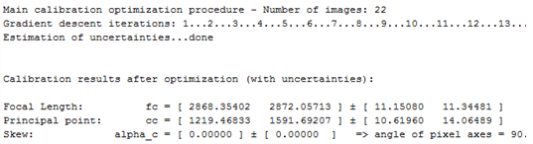
Camera Calibration with grid templates
Camera Calibration Toolbox on Matlab

Slide 17
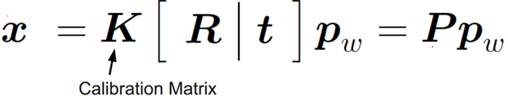
Intrinsic & Extrinsic Parameters
The transformation of point ‘pw’ from world is related to the point on image plane ‘x’ through the Projection Matrix ‘P’ which constitutes intrinsic and extrinsic parameters
Camera matrix – both intrinsic ‘K’ (focal length, principal point) and extrinsic parameters (Pose – ‘R’ rotation matrix and ‘t’ translation)
Projection Matrix or Camera Matrix ‘P’ is of dimension ‘3x4’

Slide 18
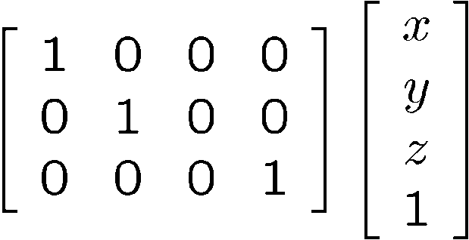
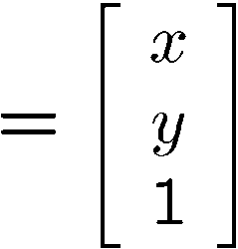

Projection Matrix ‘P’
Special case of perspective projection – Orthographic Projection
  Also called “parallel projection”: (x, y, z) → (x, y)
  What’s the projection matrix?
Image
World

Slide 19
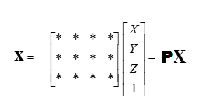
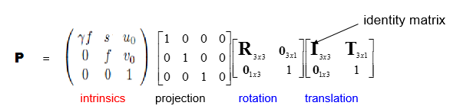
Projection Matrix ‘P’
In general, for a perspective projection Matrix ‘P’ maps image point ‘x’ into world co-ordinates ‘X’ as
  The Projection Matrix (3x4) can be decomposed into
  (3x4) (3x3) (3x4) (4x4) (4x4)

Slide 20
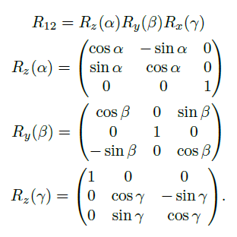
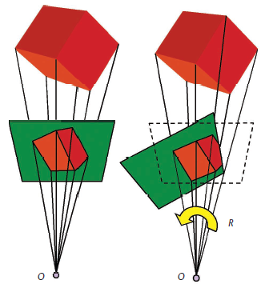
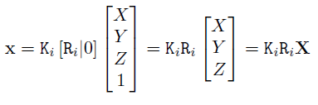

Pure Rotational Model of Camera - Homography
α,β,γ are angle changes across roll, pitch and yaw

Slide 21

Homography
Suppose we have two images of a scene captured from a rotating camera
point ‘x1 ’ in Image1 is related to the world point ‘X’ by the equation
x1 = KR1X which implies X = R1⁻¹K⁻¹ x1 ^{as}
point ‘x2 ’ in Image2 is related to the world point ‘X’ by the equation
x2 = KR2X = KR2R1⁻¹K⁻¹ * x1
Hence the points in both the images are related to each other by a transformation of Homography ‘H’
x2 = H x1 Where H = KR2R1⁻¹K⁻¹

Slide 22
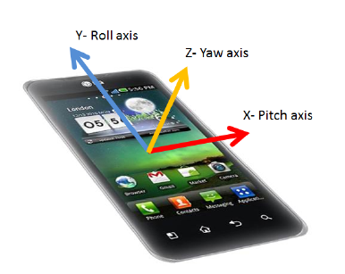
Rotation of Camera along Pitch, Roll and Yaw
If the camera is only rotating along these axes and there is zero translation, the captured images can be aligned with each other using Homography estimation
The Homography Matrix ‘H’ (3x3)can be estimated by matching features between two images

Slide 23
Image Alignment Result - Rotation of Camera along Pitch Axis

Slide 24
Image Alignment Result- Rotation of Camera along Roll axis

Slide 25
Image Alignment Result- Rotation of Camera along Yaw axis

Slide 26


Fundamental and Essential Matrices
the fundamental matrix is a 3×3 matrix which relates corresponding points in stereo images.
Stereo Images have both rotation and translation of camera
the fundamental matrix ‘F’ is a 3×3 matrix which relates corresponding points x and x¹ in stereo images.
It captures the essence of Epipolar constraint in the Stereo images.
Essential Matrix
Where K and K¹ are the Intrinsic parameters of the cameras capturing x and x¹ respectively
http://en.wikipedia.org/wiki/Eight-point_algorithm

Slide 27
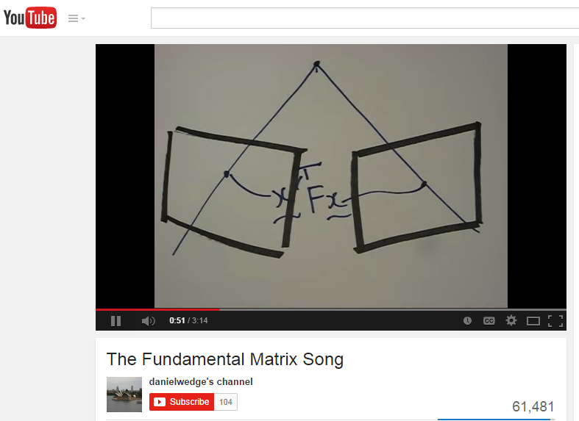
Stereo – Fundamental and Essential Matrices
https://www.youtube.com/watch?v=DgGV3l82NTk

Slide 28
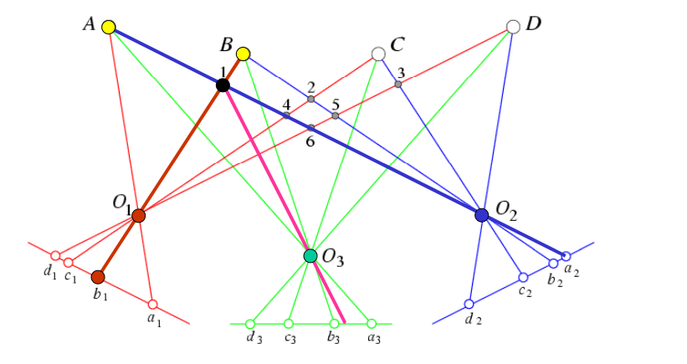
Beyond Two-View Stereo
the fundamental matrix is a 3×3 matrix which relates corresponding points in stereo images.
  Third View can be used for verification

Slide 29
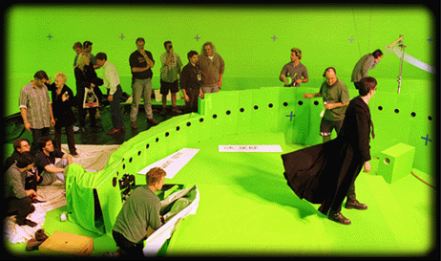
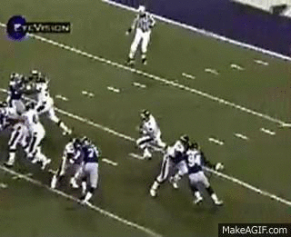
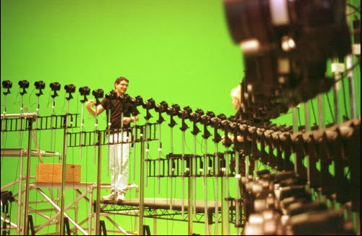
Multi-View Video in Dynamic Scenes
Reference link

Slide 30
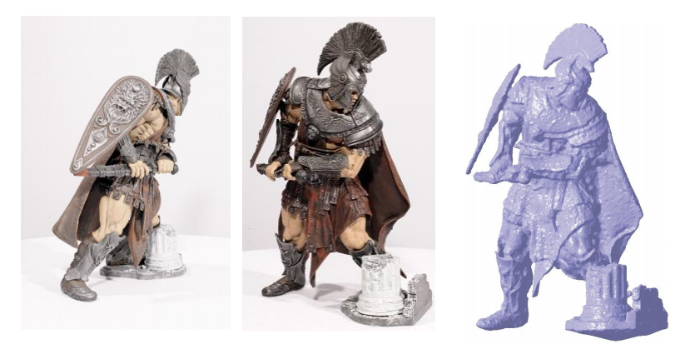
Multiple-View Geometry
the fundamental matrix is a 3×3 matrix which relates corresponding points in stereo images.
  Generic problem formulation: given several images of the same object or scene, compute a representation of its 3D shape

Slide 31
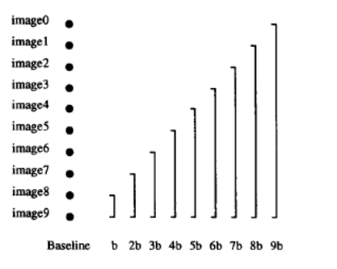

Multiple-baseline Stereo
the fundamental matrix is a 3×3 matrix which relates corresponding points in stereo images.
  Pick a reference image, and slide the corresponding window along the corresponding epipolar lines of all other images using other images
  Remember? disparity
  Where B is baseline, f is focal length and Z is the depth
  This equation indicates that for the same depth the disparity is proportional to the baseline
  M. Okutomi and T. Kanade, “A Multiple-Baseline Stereo System,” IEEE Trans. on
  Pattern Analysis and Machine Intelligence, 15(4):353-363 (1993)

Slide 32
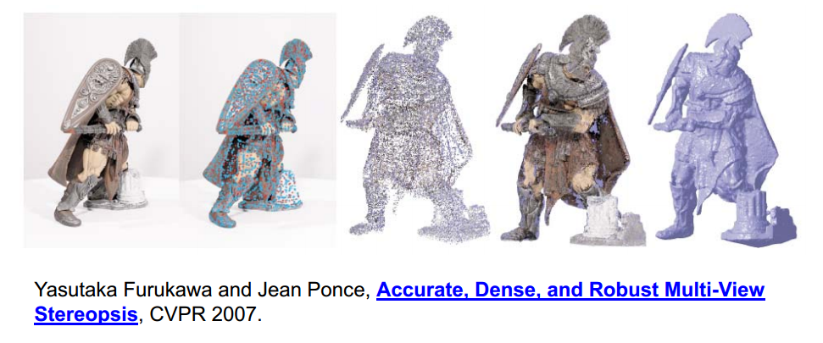
Feature Matching to Dense Stereo
the fundamental matrix is a 3×3 matrix which relates corresponding points in stereo images.
  1. Extract features
  2. Get a sparse set of initial matches
  3. Iteratively expand matches to nearby locations Iteratively expand matches to nearby locations
  4. Use visibility constraints to filter out false matches
  5. Perform surface reconstruction

Slide 33
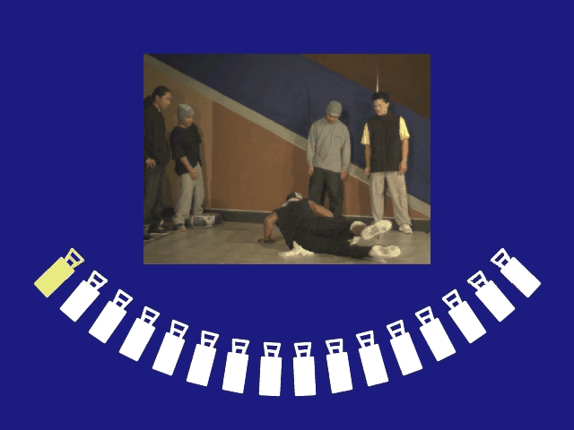
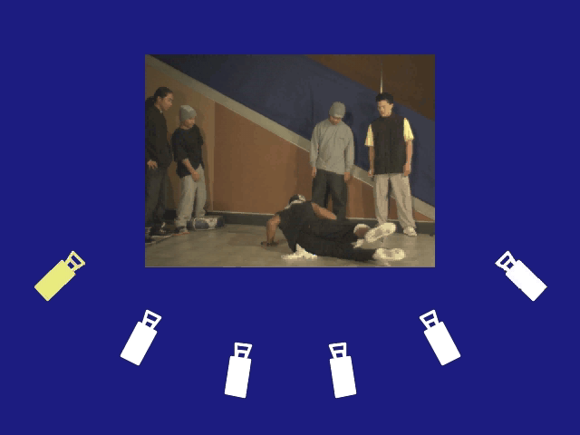
View Synthesis
the fundamental matrix is a 3×3 matrix which relates corresponding points in stereo images.
  Is it possible to synthesize views from the locations where the cameras are removed? i.e Can we synthesize view from a virtual camera

Slide 34
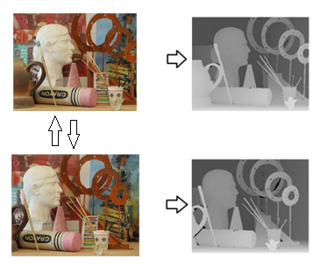
View Synthesis - Basics
the fundamental matrix is a 3×3 matrix which relates corresponding points in stereo images.
  Problem: Synthesize virtual view of the scene at the mid point of line joining Stereo camera centers.
  Given stereo images, find Stereo correspondence and disparity estimates between them.

Slide 35
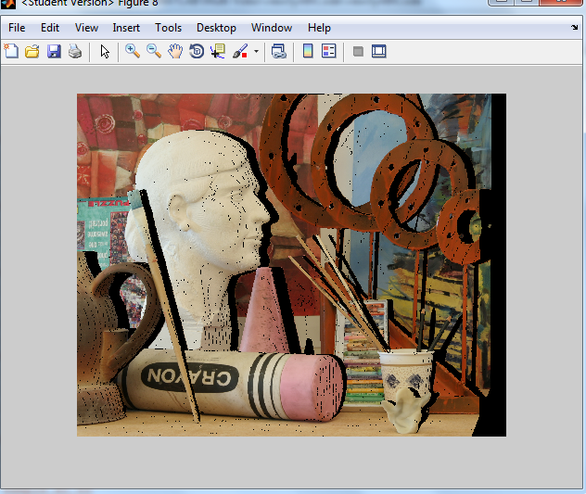
View Synthesis - Basics
  Use one of the images and its disparity map to render a view at virtual camera location. By shifting pixels with half the disparity value

Slide 36
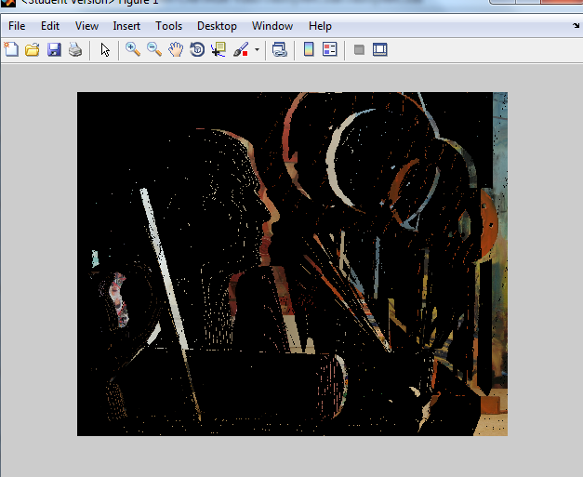
View Synthesis - Basics
  Use the information from other image to fill in the holes, by shifting the pixels by half the disparity

Slide 37
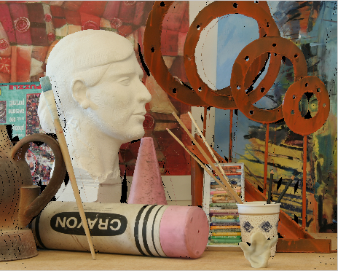
View Synthesis - Basics
  Putting both together, we have the intermediary view. We still have holes. Why??

Slide 38
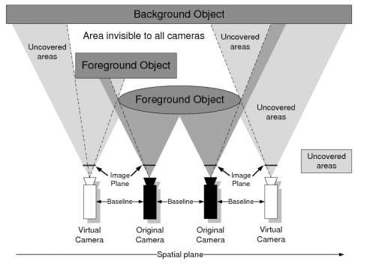
View Synthesis – Problem of Holes

Slide 39
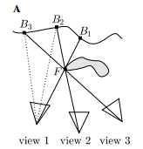
View Synthesis – Problem of Color Variation at boundaries

Slide 40
Slide Credits
  Rob Fergus, S Seitz, Lazebnik
  MATLAB Computer Vision Toolbox

